Slide 1
Oxford’s Commission on Sustainability Data

Slide 2
ESG/Sustainability Data
BP reduced CO2 emissions by 35% between 2019-2021.
Divestments: 77.4%
Sustainable emission reductions: 13.6%
Other: 9%
BP reduced CO2 emissions by 4.8% between 2019-2021. This is expected behavior when we ask a company to lower sustainability metrics.
Notes:
Make a table

Slide 3
What Behavior Are Driving?
Market understands advantage
Market rewards
Company creates advantage
Market doesn’t have way to compare to other choices
Nothing
Un-auditable, company specific claims
Better, Faster, Cheaper is Observable
Sustainability Is Not Observable
Virtuous Cycle (Better, Faster, Cheaper)
Today’s Sustainability Reality

Slide 4
We Can Make Sustainability Observable
By providing data in a way that standardizes and maintains auditability
Market understands advantage
Market rewards
Company creates advantage
Virtuous Cycle (Better, Faster, Cheaper, Sustainable)

Slide 5
See the World As a Series of Transactions
“Company” view is a shell game.
Transactional data can make sustainability observable.

Slide 6
Leveraging Natural Advantages of Transactional Data to Drive Sustainability Forward

Slide 7
Transactions Are Never Unique and Never Alone
Universal data in + interlocking nature of transactions = path to auditable observability
All transactions have universal, basic data.
eCommerce
That universal, basic data is enough to answer sustainability questions.

Slide 8
Transactions Are Never Alone
Universal data in + interlocking nature of transactions = path to auditable observability
Seller
Buyer
Payment
Given enough transactional data you create a dataset that audits itself.
eCommerce
All important transactional data intertwines with other transactional data
Shipping Vendor
Tax Calc

Slide 9
Transactions Are Never Alone
Universal data in + interlocking nature of transactions = path to auditable observability
Seller
Buyer
Seller
Buyer
Payment
Payment
Payment
Payment
eCommerce
Procurement
Procurement
Inventory
Commerce Solution
Shipping Vendor
Tax Calc
Shipping Vendor

Slide 10
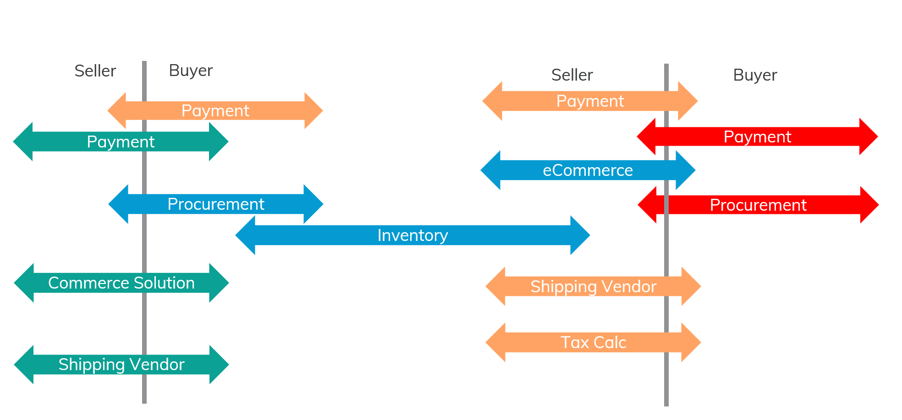
Where to Create Competition
Wealth creation occurs at point of competition.
Reporting competition brings reporting optimization.
Process competition brings process
optimization.

Slide 11
Logging Sustainability Data Must Be Normalized
Log universal data to your company’s private ESG/Sustainability database.

Slide 12
Conflicting Requirements for Auditable Solution
Understanding the requirements
Customer and Market Requirements
Companies want complete ownership of their data
Important software companies want their systems to store this data
Requirements for Universal Auditability
Companies can’t be allowed to modify their transactional data
Transactional data must be standardized and logged in a way that maintains interlocking nature and auditability

Slide 13
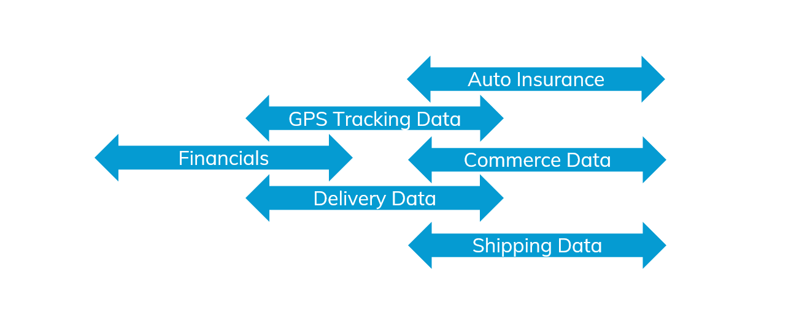
How to Enable Standardization and Auditability
Standardization & Auditability
Standardized Table Definitions
Mutualized Sustainability Entity
Data
Hash
Certified Database Provider
Company
Log universal data to your company’s private ESG/Sustainability database.

Slide 14
Cost of Fraud and Business Opportunity
Solution front loads significant direct costs of fraud, future costs of fraud become unknown.
What fraud would now cost
Double purchase of software systems
Have sophistication to orchestrate real-time data generation through second set of software systems
Participation in AI and collaboration suffers
All new initiatives require thinking through how fraud is conducted
Future external requirements from customers or governments is an unknown
Benefits of honestly engaging sustainably
Universal, Standardized, Trusted, Transactional Data
Tax
Collaboration
Sustainability
AI

Slide 15
Oxford’s Commission on Sustainability Data
Here we go!
Oxford
Consumers
Governments
Finance
Industry

Slide 16
Working examples of interlocking data.

Slide 17
Data Elements Are Universal
Interlocking nature of transactions + data elements is universal
eCommerce
Payment
eCommerce
Shipping
Internal Data
External Data

Slide 18
Data Elements Are Universal
All systems that handle a particular process share common data elements
eCommerce
Payment
Shipping Vendors
commerce
Vendor
Order Number
Date/Time
Product
Quantity
Price
Tax (from Tax)
Ship to address
Payment
Customer
Tracking Number (from shipping)
tax and file
Vendor
Transaction ID
Date
Price
shir
Vendor
Order Number
Ship from address
Ship to Address
Tracking Number
Shipping Method (ground, air)

Slide 19
Data Elements Are Universal
All systems that handle a particular process share common data elements
eCommerce
Payment
Shipping Vendor
commerce
Vendor
Order Number
Date/Time
Product
Quantity
Price
Tax (from Tax)
Ship to address
Payment
Customer
Tracking Number (from shipping)
tax and file
Vendor
Transaction ID
Date/Time
Price
shir
Vendor
Order Number
Ship to address
Ship from Address
Tracking Number
Shipping Method (ground, air)
Audit
Sustainability AI/practitioner can now audit data

Slide 20
Data Elements Are Universal
All systems that handle a particular process share common data elements
eCommerce
Payment
Shipping Vendors
commerce
Vendor
Order Number
Date/Time
Product
Quantity
Price
Tax (from Tax)
Ship to address
Payment
Customer
Tracking Number (from shipping)
tax and file
Vendor
Transaction ID
Date
Price
shir
Vendor
Order Number
Ship to address
Ship from Address
Tracking Number
Shipping Method (ground, air)
Audit
Sustainability AI/practitioner can now audit data

Slide 21
Data Elements Are Universal
All systems that handle a particular process share common data elements
eCommerce
Payment
Shipping Vendors
commerce
Order Number
Data/Time
Product
Quantity
Price
Tax (from Tax)
Ship to address
Payment
Customer
Tracking Number (from shipping)
tax and file
Transaction ID
Date
Price
shir
Vendor
Order Number
Ship from address
Ship to Address
Tracking Number
Shipping Method (ground, air)
Calculate
Sustainability AI/practitioner can now calculate CO2

Slide 22
Concept Spans Many Elements of ESG
Interlocking nature of transactions + data elements is universal
Internal Transportation
Auto Insurance
Telematics (GPS) Data
Delivery Data
Payments
Shipping Orders
Internal Data
External Data

Slide 23
Concept Spans Many Elements of ESG
Interlocking nature of transactions + data elements is universal
Human Resources
HR
Payroll
Internal Data
External Data

