Slide 1
Oxford Net Zero
Who are we and what do we do?
Dr. Stuart Jenkins and Dr. Alice Evatt

Slide 2
THE ONZ INITIATIVE
Oxford Net Zero is a multi-disciplinary initiative based within the School of Geography and the Environment (SoGE).
We address the critical issue of how to reach global ‘net zero’ and halt global warming
ONZ draws on the University’s world-leading expertise in climate science and policy. It brings together leading academics from across the University’s disciplines, including Geography, Physics, Philosophy, Economics, Biology, Anthropology, Law and Earth Sciences.
The initiative provides actionable research and new resources for policymakers and businesses at this critical juncture for international action on climate change.
More detail is available on our website.

Slide 3
THE ONZ TEAM
Senior Leadership:
The Programme Team:
Details and bios of the team are available on the website
THEO BREAKSPEAR
ADMINISTRATOR

Slide 4
How has the team grown?
2020 | 2024
○●● | ●●● Directors
●●●●●●●●● | ●●●●●●●●●●●● Co-Investigators
○○○○● | ●●●●●●●●● ●● Fellows
 | ●●●●●●● Researchers
○○ | ●●○ Programme Team
○○○○○○○○○ | ●●●●●●●●●●●●●●●●●●●●●● Associates
57 people (cf 28 in business case)
10 departments across the University of Oxford
11 from external institutions including Universities, NGO’s and companies
KEY: Open Circle = vacancy ●School of Geography & the Environment (including Smith School and ECI) ●Department of Physics ●Blavatnik School of Government ●Department of Earth Sciences ●Oxford Martin School ●School of Anthropology & Museum Ethnography ●Department of Biology ●Faculty of Law ● Saïd Business School ●Businesses ●Other Universities ●Standards Bodies ●NGOs ●Department of Chemistry ● Faculty of Philosophy ●Not specified
Notes:
Can now search for topic experts on https://netzeroclimate.org/about-us/ (via QR code) (keep scrolling down to get to the team)
Associates from: BSI, Berkley, Harvard, Hilton Food Group (in the audience), Cardiff University, Carbon Balance Initiative, as well as the departments listed

Slide 5
THE ONZ TEAM
Net Zero for the Fossil Fuel Sector
DR STUART JENKINS
DR ALICE EVATT
Physical climate change and the design of credible climate policy
Socio-economics of a global net zero transition
Carbon storage market design, regulation, risks, and use cases
Policy suites which guarantee net zero
The role of the fossil fuel sector in net zero world and net zero transition
Viewpoints and discourse of various actors: govts. corporates, public

Slide 6
OUR VISION
Our vision is to operationalize net zero as a framework with social and environmental integrity that advances climate action and sustainable development at multiple scales
We will do this by conducting transformative research, promoting an integrated international research community and engaging with national and international processes as well as businesses, policymakers and civil society.

Slide 7
ONZ IMPACT AREAS
Integrated International Research Community
Transformative Research
Policy, Business and Public Engagement on Net Zero
Nine Work Packages; three per impact area

Slide 9
Notes:
What next? Themes – this is from the draft of the overview leaflet

Slide 10
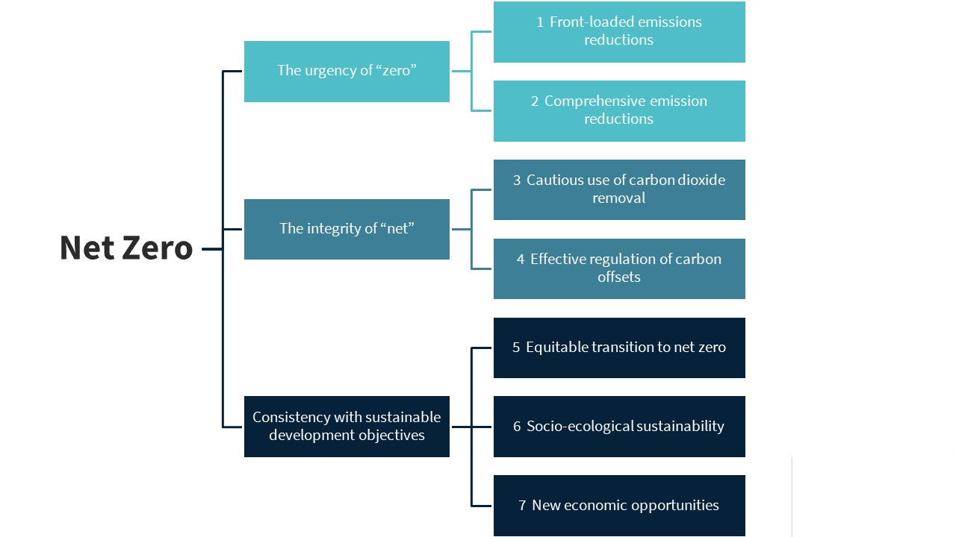
INFORMING THE DEBATE TO GET NET ZERO RIGHT
We have identified 7 attributes of net zero, which our research analyses and promotes
Fankhauser, S., Smith, S.M., Allen, M. et al. The meaning of net zero and how to get it right. Nat. Clim. Chang. 12, 15–21 (2022)..

Slide 11
DEFINING NET ZERO FOR THE HARD-TO-ABATES
Net Zero Fossil Fuel Fellows focus on the attributes of net zero for the most challenging sectors
Engagement with fossil fuel extractors, steel and cement, chemicals production, heavy industry, aviation etc.
The design and application of appraisal structures which assess a company's net zero policy against the requirements for a durable, just, and equitable net zero transition.
The design of public policy and regulations which guarantee a net zero transition in line with Oxford's understanding of best-practise climate policy.

Slide 12
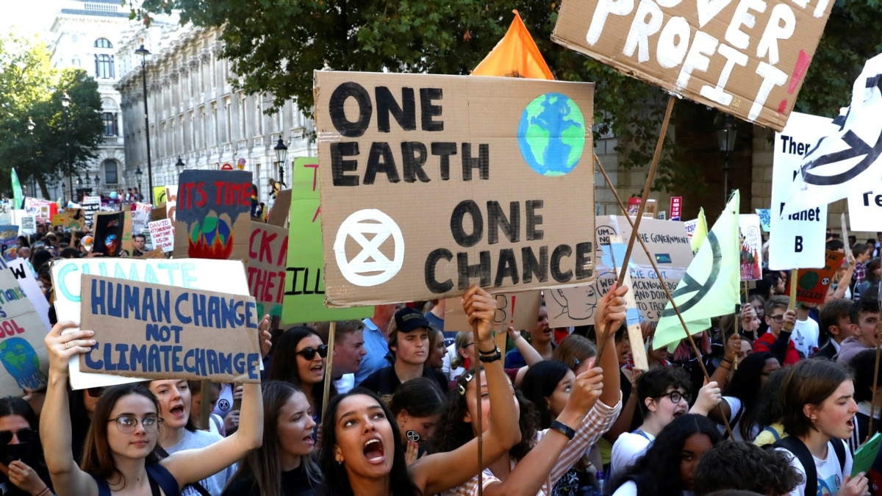
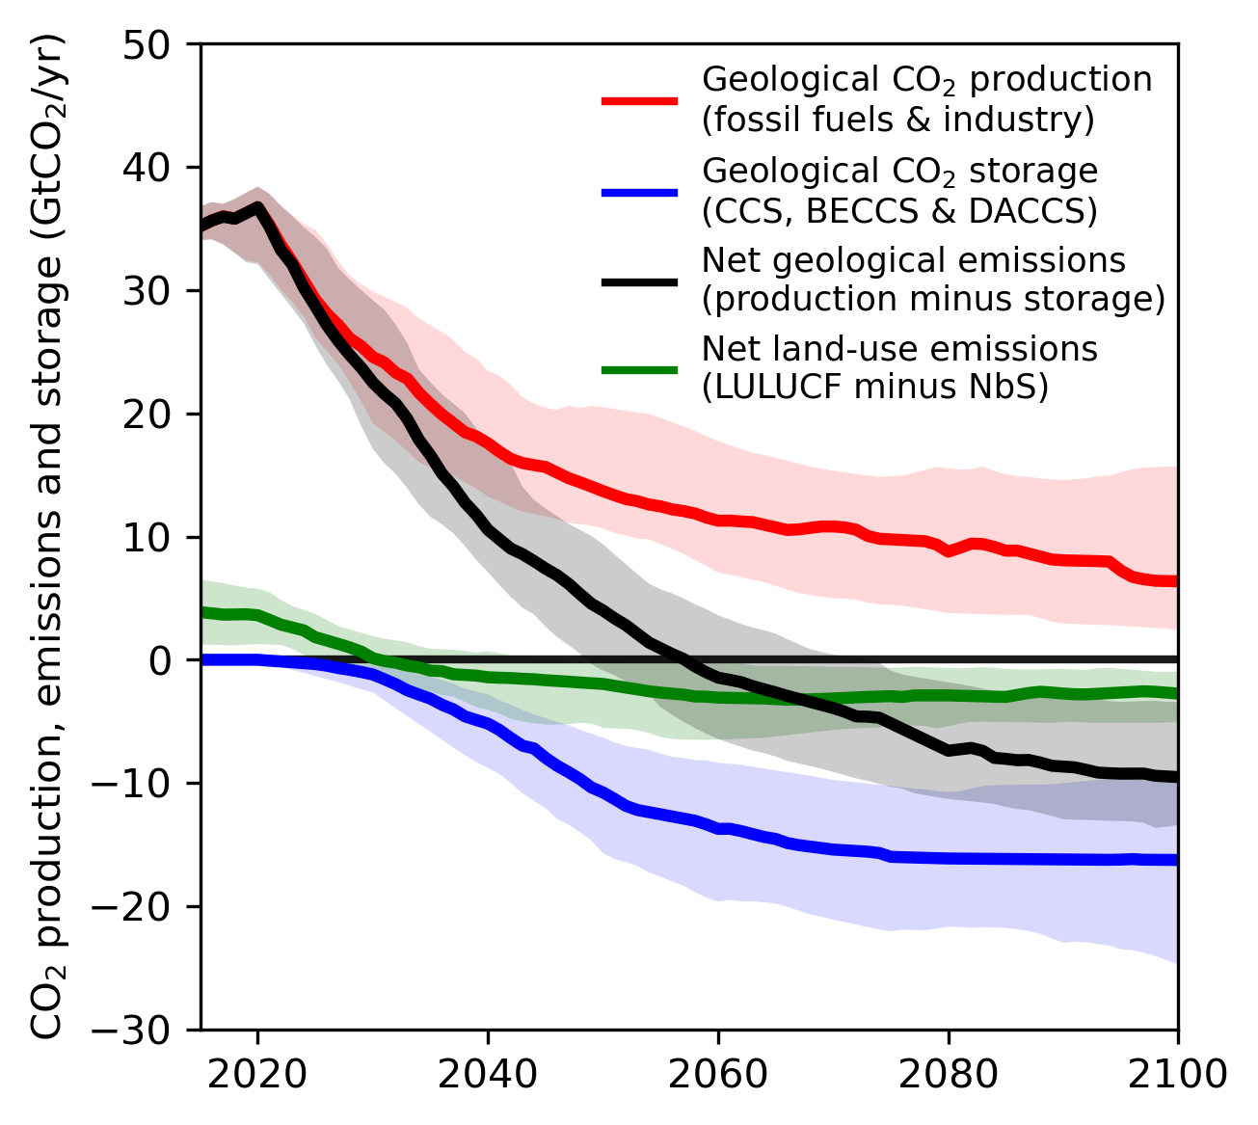
CRITICAL ENGAGEMENT WITH THE FOSSIL FUEL SECTOR
Financial Interactions and partnerships with the fossil fuel sector are starting to be critically assessed.
The fossil fuel sector is under increasing pressure to "clean up or clear off".
Financial institutions, investors, governments etc. are all under pressure to demonstrate critical assessment of their relationships with fossil fuel extractors.
Ambitious net zero policy very likely includes the use of carbon capture and geological storage, at multi-billion-tonne-per-year scale by 2050.
The fossil fuel industry is well placed (the only actors who can?) to deliver this aspect of the net zero story.
Are they trusted to do so?

Slide 13
The Glasgow Financial Alliance for Net Zero (GFANZ) is a global coalition of leading financial institutions committed to accelerating the decarbonization of the economy.
Dual Purpose:
Expand the number of net zero-committed financial institutions
Establish a forum for addressing sector-wide challenges associated with the net-zero transition, helping to ensure high levels of ambition are met with credible action.
Raise Ambition: Encourage firms to set commitments that are backed by robust targets and transition plans
CRITICAL ENGAGEMENT WITH THE FOSSIL FUEL SECTOR
Notes:
GFANZ was launched established 18 months ago by former Bank of England Governor Mark and UN Special Envoy on Climate Action and Finance Mark Carney together with the COP26 presidency, in partnership with the UNFCCC Race to Zero campaign. Funded by philanthropist and UN Special Envoy for Climate Ambition Michael Bloomberg.
GFANZ is a private sector-led initiative. It is a coalition of eight independent net-zero financial alliances, comprised of over 600 member firms from across the finance industry overseeing a combined $130 trillion in assets. Represents 50+ countries. Alliance members include banks, insurers, asset owners, asset managers, financial service providers, and investment consultants.
Aim: coordinate efforts across all sectors of the financial system to accelerate the transition to a net-zero global economy and helping achieve the objectives of the Paris Agreement.

Slide 14
“
Any fossil fuel financing — to ensure continuity of energy supply in the interim — should be consistent with a 1.5°C pathway to ensure the energy sector continues along a net-zero transition and is not creating assets that will be stranded
”
November 2022
Notes:
Transitioning Away from Fossil Fuels: Financial institutions are encouraged to support the transition away from fossil fuels by implementing policies that restrict funding for projects related to the exploration and development of new oil and gas fields, construction of new oil power plants, and other activities that contribute to carbon emissions
Phasing Out Fossil Fuel Financing: Some financial institutions have committed to phasing out financing for new thermal power generation using fossil fuels, including coal, petroleum, and gas. This aligns with the broader goal of transitioning to cleaner energy sources and reducing reliance on fossil fuels
Exit Strategies: Certain financial institutions have set specific timelines for exiting investments in oil production or for discontinuing support for projects related to unconventional oil and gas sectors. These exit strategies demonstrate a commitment to aligning financial activities with net-zero transition goals

Slide 15
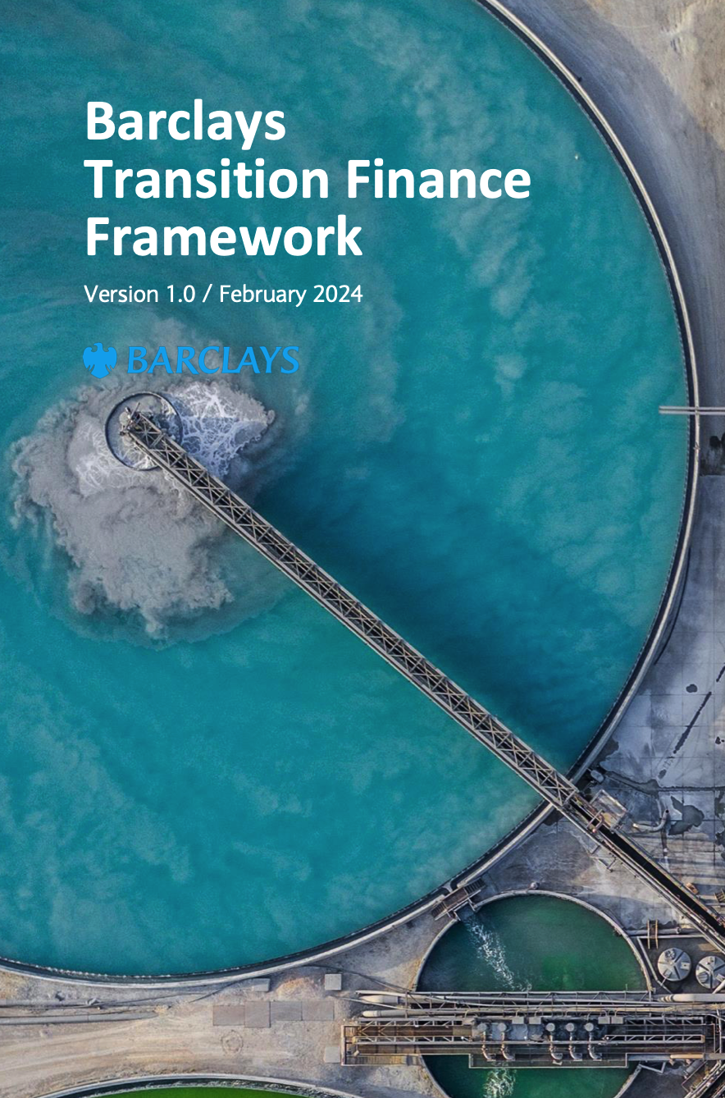
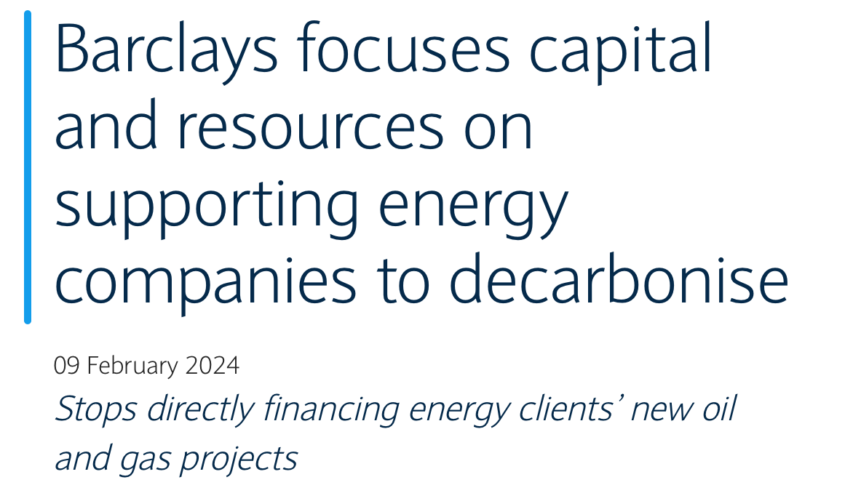
FOSSIL FUEL FINANCING
Client Transition Framework (CTF)
Requirements for energy clients to have 2030 methane reduction targets, a commitment to end all routine / non-essential venting and flaring by 2030 and near-term net zero aligned Scope 1 and 2 targets by January 2026.
Expectation for energy clients to produce transition plans or decarbonisation strategies by January 2025.
Notes:
Published a revised Climate Change Statement to progress its climate strategy together with a Transition Finance Framework, which outlines criteria for transition finance transactions.
Net Zero Ambition: ambition to be a net zero bank by 2050
Introduces restrictions for new and non-diversified oil and gas clients engaged in expansion.
Establishes clear expectations of transition strategies and decarbonisation requirements for energy clients.
Commitment to finance $1trillion of Sustainable and Transition Finance by 2030
Climate Change Statement:
A three-part strategy reducing financed emissions, and financing the transition to a low-carbon economy
1. Focuses on achieving net-zero operations: Reduce its Scope 1, Scope 2 and Scope 3 operational emissions consistent with a 1.5°C aligned pathway and counterbalance any residual emissions.
2. Reduce Financed emissions
3. Finance the transition to a low-carbon economy
Fossil fuels: Client Transition Framework:
Barclays requires Energy Groups to have a transition plan or decarbonization strategy in place as part of their Client Transition Framework (CTF) assessment. The CTF assesses Energy Groups' plans for alignment with Barclays' emissions reduction targets and considers factors such as Scope 1 and 2 emissions reduction targets, Scope 3 absolute emissions reduction targets/commitments, plans to expand production, and low carbon business model activities and plans
By January 1, 2025, Barclays expects all Energy Groups to be producing relevant information regarding their transition plans or decarbonization strategies.
The CTF assessment informs the Client Transition Review Forum (CTRF) reviews, which help determine Barclays' financing appetite and implications for emissions reduction targets, commercial, credit, and reputational impacts. Energy Groups meeting specific criteria are subject to mandatory annual review by the CTRF to assess the appropriateness of continued financing support in the context of their investment plans and overall decarbonization or transition plans
We assess the information available on Energy Groups’ plans for alignment with our emissions reduction targets through the Client Transition Framework (CTF) against several factors including, but not limited to, the following: • Scope 1 and 2 emissions reduction targets, including methane. • Scope 3 absolute emissions reduction targets/ commitments. • Plans to expand production. • Low carbon business model activities and plans. By 1 January 2025, we expect all Energy Groups to be producing relevant information in relation to their transition plans or decarbonisation strategies
No general corporate purpose financing for new or material expansion of thermal coal-fired power plants. New restrictions on financing upstream oil & gas, as well as Enhanced Due Diligence (EDD) requirements for biomass
Transition Finance Framework.
purpose of the Transition Finance Framework outlined in the Barclays document is to provide a transparent methodology for classifying financing as transition

Slide 16
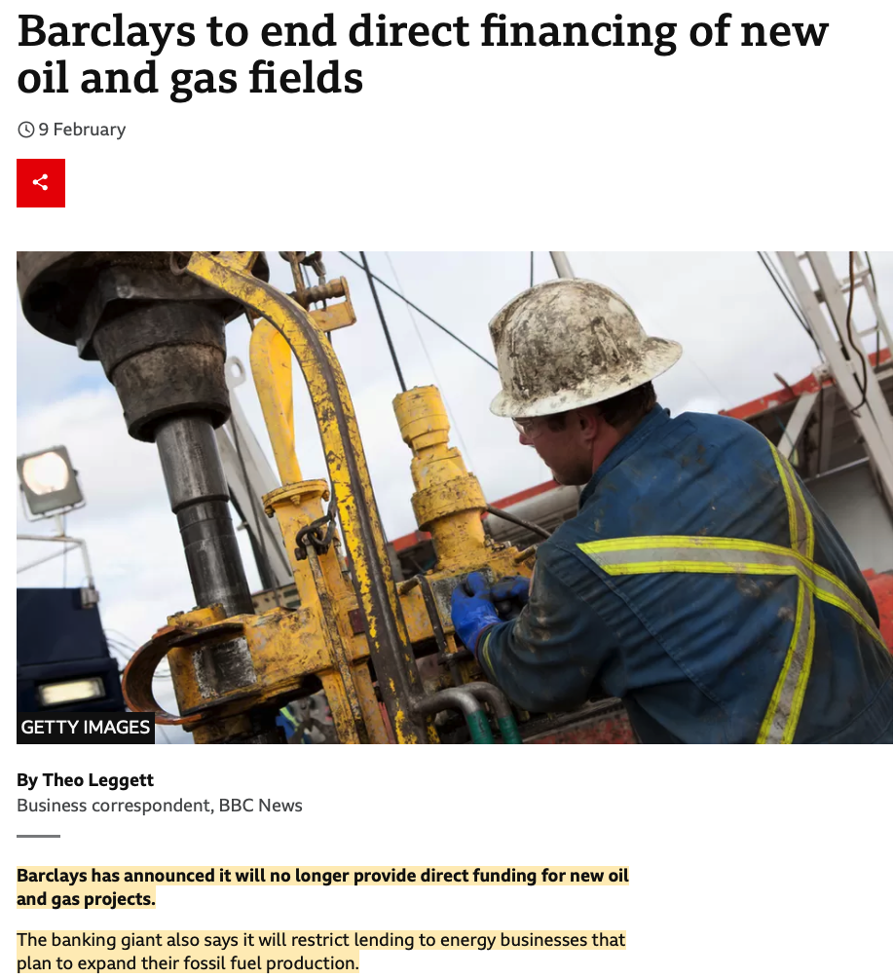
FOSSIL FUEL FINANCING
BBC NEWS. “Barclays to End Direct Financing of New Oil and Gas Fields,” February 9, 2024.

Slide 17
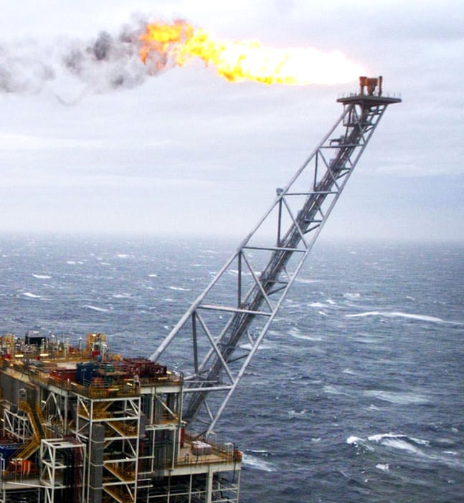
UK OFFSHORE FOSSIL FUEL SECTOR
Government licensing appraisal process requires urgent revision
Current licensing checkpoint comprises three tests:
Future licensing could also be contingent on:
1) Is UK offshore sector scope 1 and 2 emissions trajectory Paris-compliant? […plus scope 3 trajectory?]
2) Is the UK a net importer of fossil fuels?
3) Is UK extraction lower emissions intensity than the global average? [...than global alternatives?]
4) Is the extractor committed to a rising fraction of the CO2 produced from this extraction being recaptured and stored?
5) Is the extractor demonstrating investment indicative of support for a societal net zero transition?

Slide 18
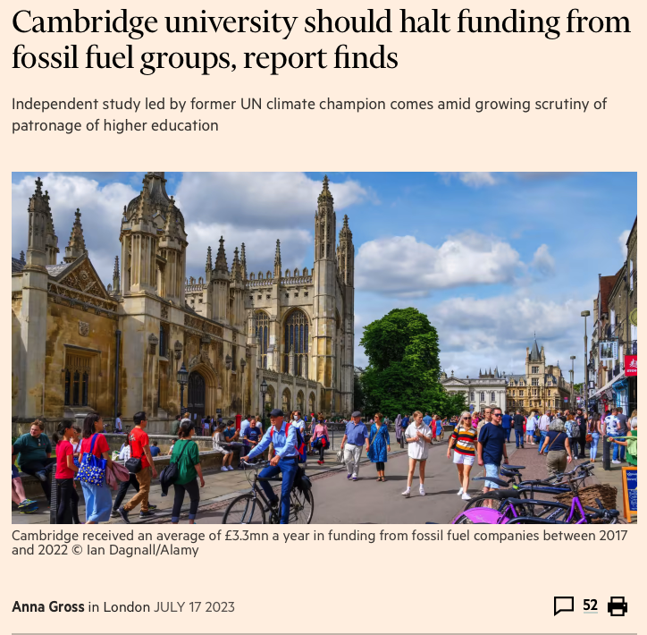
UNIVERSITY ENGAGEMENT WITH THE FOSSIL FUEL SECTOR
Colbert, Max. “UK Universities Take £40m in Fossil Fuel Funding since 2022.” The Guardian, October 4, 2023, sec. Environment.
Gross, Anna. “Cambridge University Should Halt Funding from Fossil Fuel Groups, Report Finds,” July 17, 2023.
Notes:
In July 2022, 84 members of the Regent House submitted a Grace3 [the Grace] to the Cambridge University Council [the Council], as follows.
The Regent House asks the Council to agree that the University of Cambridge will not accept research funding or allow sponsorship or other collaborations with companies if they meet one or more of the following criteria:
∙ They are constructing, or facilitating the construction of, new fossil fuel infrastructure. ∙ They are engaged in exploring, or facilitating the exploration of, new fossil fuel reserves. ∙ They retain membership with trade associations engaged in political lobbying against science-based climate legislation.
Report: Grace on Fossil Fuel Industry Ties A report into the impacts of implementing the Grace on fossil fuel industry ties on Cambridge University’s mission. Nigel Topping July 2023

Slide 19
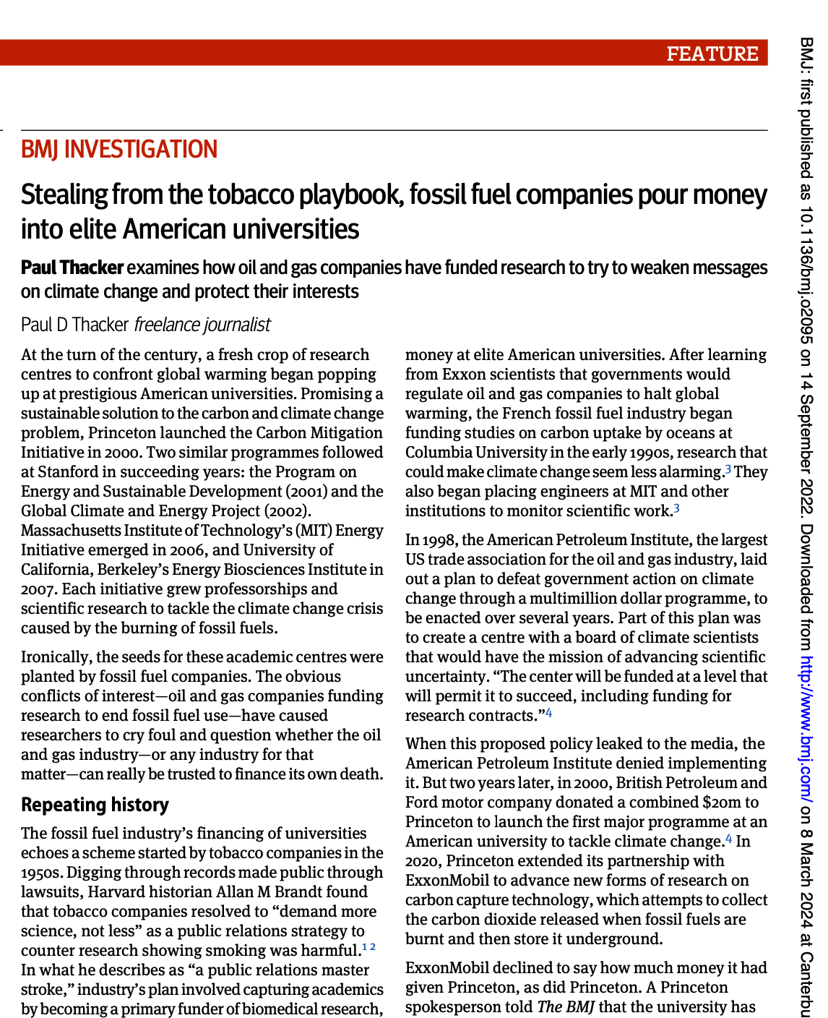
UNIVERSITY ENGAGEMENT WITH THE FOSSIL FUEL SECTOR
“
We can look at other examples of industries that have funded research related to their products…
… Often the reasons are to obtain the trust of scientists, to paint themselves as part of the solution to the broader public, to keep an eye on what research is being done - even to influence what research gets done, what doesn't get done.
”
-- Benjamin Franta
Thacker P D. Stealing from the tobacco playbook, fossil fuel companies pour money into elite American universities BMJ 2022; 378 :o2095
Notes:
Dr Benjamin Franta
Senior Research Fellow in Climate Litigation
Many students are calling for their universities to cut ties with the fossil fuel industry
An investigation published by The BMJ today takes an in-depth look at how fossil fuel companies pour money into prestigious American universities.
Investigative journalist Paul Thacker examines how oil and gas companies have funded research to try to weaken messages on climate change, capture academia, and protect their interests, much like tobacco companies did half a century ago.
One of the first systematic examination of fossil fuel funding influence across multiple elite campuses.
Report: Grace on Fossil Fuel Industry Ties A report into the impacts of implementing the Grace on fossil fuel industry ties on Cambridge University’s mission. Nigel Topping July 2023 CAMBRIDGE

Slide 20
OXFORD’S STRATEGY: DEFINING NET ZERO FOR THE HARD-TO-ABATES
The approach of the university today follows three basic principles:
The Oxford Martin Principles for Climate Conscious Investment
1)
2)
3)
NET ZERO COMMITMENT
All scopes
Credible definition of net zero
PROFITABLE NET ZERO BUSINESS PLAN
Recognition of scale of energy market change
MEDIUM TERM TARGETS
Targets which allow the tracking of progress

Slide 21
OXFORD'S STRATEGY: DEFINING NET ZERO FOR THE HARD-TO-ABATES
Next steps: engaging with fossil fuel corporates on their transition planning
We have identified four key areas for engagement with fossil fuel companies:
Policy
Definition of net zero includes understanding of permanence of storage
Policy includes analysis of risks to net zero strategy + mitigation strategies
Advocacy
Advocates for credible net zero policy in public and private settings
Vocal on issues which are key to the net zero business plan of their sector/organisation
Economic/investment
Investment strategy demonstrates movement towards new business model
Size of operation important – large extractors must acknowledge reality of oil and gas market transformation
Technical
Where reliance is place on technological solutions, is sufficient research and technical understanding being demonstrated?
Are trajectories of emissions production compatible with 'ambitious mitigation'?

Slide 22
OXFORD’S STRATEGY: DEFINING NET ZERO FOR THE HARD-TO-ABATES
Where information is lacking transparency, or even missing, this appraisal process falls apart...
The Oxford Martin Principles for Climate Conscious Investment
1)
2)
3)
NET ZERO COMMITMENT
All scopes
Credible definition of net zero
PROFITABLE NET ZERO BUSINESS PLAN
Recognition of scale of energy market change
MEDIUM TERM TARGETS
Targets which allow the tracking of progress
Tracking progress requires detailed and transparent insight into company CO2 emissions over time

