Slide 1
Oxford’s Commission on Sustainability Data

Slide 2
ESG/Sustainability data
Public Company reported they reduced CO2 emissions by
35%
between 2019 - 2021
77.4%
13.6%
9%
Divestments
Sustainable emission reductions
Other
Public Company reduced CO2 emissions by 4.8% between 2019-2021.
This is expected behavior when we ask a company to lower sustainability metrics
Notes:
Make a table?
BP reduced CO2 emissions by 4.8% between 2019-2021. This is expected behavior when we ask a company to lower sustainability metrics.
Divestments: 77.4%
Sustainable emission reductions: 13.6%
Other: 9%

Slide 3
What behaviors are driving?
Market understands advantage
Market rewards
Company creates advantage
Market doesn’t have way to compare to other choices
Nothing
Un-auditable, company specific claims
Better, Faster, Cheaper is Observable
Sustainability Is Not Observable
Virtuous Cycle
(Better, Faster, Cheaper)
Today’s Sustainability Reality

Slide 4
We can make sustainability observable
By providing data in a way that standardizes and maintains auditability
Market understands advantage
Market rewards
Company creates advantage
Virtuous Cycle
Better
Faster
Cheaper
Sustainable

Slide 5

See the world as a series of transactions
“Company” view is a shell game
Transactional data can make sustainability observable

Slide 6
Leveraging natural advantages of transactional data to drive sustainability forward

Slide 7

Transactions are never unique and never alone
Universal data in + interlocking nature of transactions = path to auditable observability
All transactions have universal, basic data
eCommerce
That universal, basic data is enough to answer sustainability questions
Notes:
1 – governments are seeking to close the VAT gap
2 – governments roll out e-invoicing mandates that businesses are required to adopt
3 – businesses turn to platforms they use to run their business for an e-invoicing solution
4 – platforms can partner with Avalara
Separate slide w/ actual benefits
Definitions
E-invoicing: the process of sending and receiving invoices in a digital, structured format
Live reporting: the process of reporting business data to tax authorities in real time
----------------------
ORIGINAL SLIDE COPY
The Future of Compliance
By 2024, 45%+ of European GDP will be covered by an e-invoicing mandate
Invoicing is driven by governments seeking to close the tax gap of €93B (2020)
Governments increasing focus on invoice content
Invoices are only as valuable as the accuracy of the compliance data
Requirement to create invoices that are required by regulations/e-invoicing mandates AND infuse them with the data that make the invoice compliant
Tariff & duty classifications & calculations
Tax classifications & calculations
Issues must quickly be resolved within the same system
The Avalara Solution
Delivered via a singular API
Avalara is the global leader in tax compliance & is becoming the global leader in e-invoicing
Decades of compliance market leadership
Partnership DNA & dedicated team
Collaborative & merchant-centric approach
Deep legislative expertise
Flexibility to make solution work for our partners
Track record of highly successful partnerships that scale

Slide 8
Transactions Are Never Alone
Universal data in + interlocking nature of transactions = path to auditable observability
SELLER
BUYER
Payment
Given enough transactional data you create a dataset that audits itself.
eCommerce
All important transactional data intertwines with other transactional data
Shipping Vendor
Tax Calc

Slide 9
Transactions Are Never Alone
Universal data in + interlocking nature of transactions = path to auditable observability
SELLER
BUYER
SELLER
BUYER
Payment
Payment
Payment
Payment
eCommerce
Procurement
Procurement
Inventory
Commerce Solution
Shipping Vendor
Tax Calc
Shipping Vendor

Slide 10
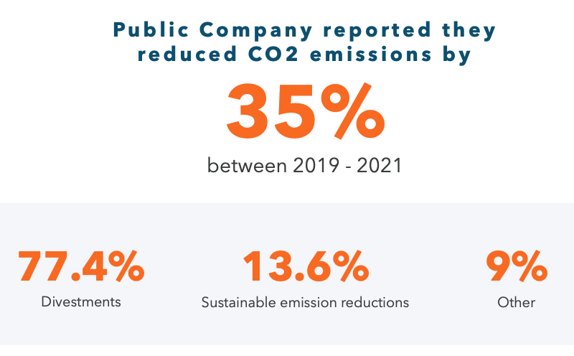
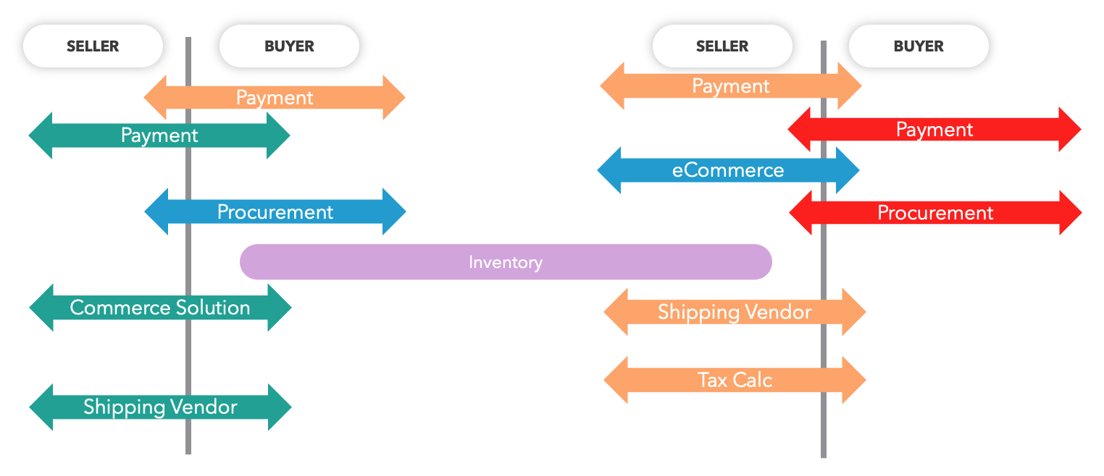
Where to create competition
Wealth creation occurs at point of competition
Reporting competition brings reporting optimization
Process competition brings process
optimization
Notes:
Make a table?
BP reduced CO2 emissions by 4.8% between 2019-2021. This is expected behavior when we ask a company to lower sustainability metrics.
Divestments: 77.4%
Sustainable emission reductions: 13.6%
Other: 9%

Slide 11
Logging sustainability data must be normalized
Log universal data to your company’s private ESG/Sustainability database

Slide 12
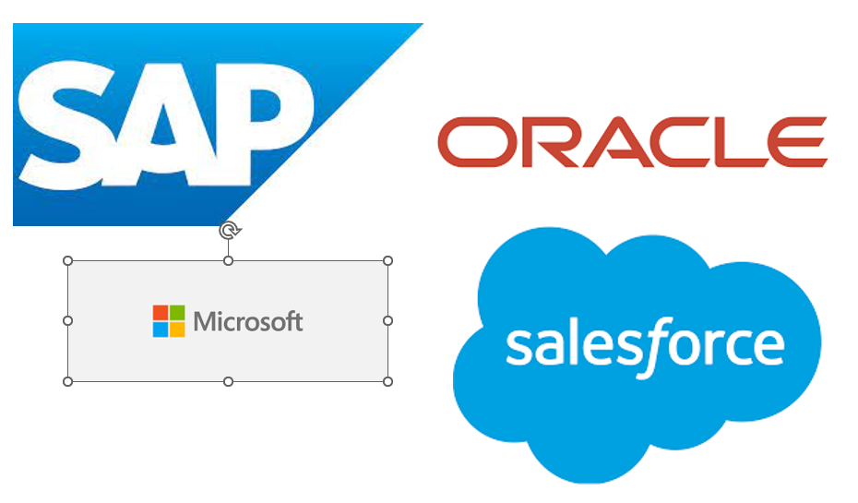

Conflicting requirements for auditable solution
Understanding the requirements
Requirements for Universal Auditability
Customer and Market Requirements
Companies can’t be allowed to modify their transactional data
Transactional data must be standardized and logged in a way that maintains interlocking nature and auditability
Companies want complete ownership of their data
Important software companies want their systems to store this data

Slide 13
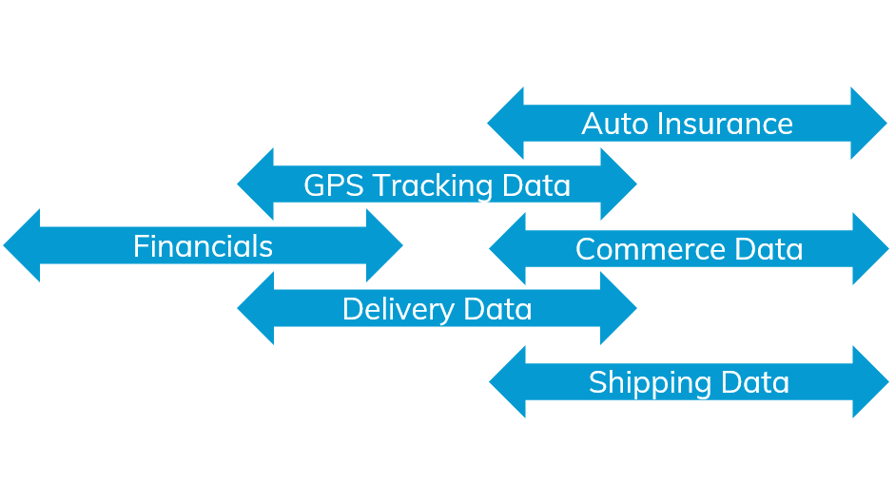
How to enable standardization and auditability
Standardization & Auditability
Certified Database Provider
Mutualized Sustainability Entity
Standardized Table Definitions
TRANSACTIONAL DATA
HASH
Company
Log universal data to your company’s private ESG/Sustainability database

Slide 14
Cost of fraud and business opportunity
Solution front loads significant direct costs of fraud, future costs of fraud become unknown.
Benefits of honestly engaging sustainably
What fraud would now cost
  Double purchase of software systems
  Have sophistication to orchestrate real-time data generation through second set of software systems
  Participation in AI and collaboration suffers
  All new initiatives require thinking through how fraud is conducted
  Future external requirements from customers or governments is an unknown
Universal, Standardized, Trusted, Transactional Data
Tax
Collaboration
Sustainability
AI

Slide 15

Commission on Sustainability Data
Update for the Commission
8 March 2024
Anders Knox, Cindy Rose

Slide 16
What we’ll cover:
Briefly, what the project aims to do
Steps taken to get project off the ground
Where things stand (at 8 March 2024)

Slide 17
What the Sustainability Data project aims to do
prove that companies’ sustainability-related data can be verified
  gives consumers / investors more information when making purchasing, investment decisions.
  impact purchasing behaviour, cost of capital.
Standardise definitions for metrics
encourage market to expect accurate, reliable sustainability-related data that drive improvement

Slide 18
Understanding what is stored and where
What is stored in company’s private database?
2/2/2024, sold 5, rubix cubes, to-Paul, $23.23
What is stored at central entity?
a0cf4bf35331da7411eff1254889fccd69c5c5646b8f2a52ece8532da42af96f7c448c9f7bdacc83e93e4f8fca93447f

Slide 19
What was required for this to work
Data needs to have common elements
Data needs to intertwine enough to make auditable

Slide 20
What was required for this to work
Companies need to see this as valuable
  Reputation
  Cutting cost for audits related to sustainability
Comfortable with approach
  CEO, IT, Legal, Head of Finance
    Key - Logging data to company’s database
  Hash going to 3rd party entity
    Even though hash behind encryption seen as in the wild
    Oxford only needs 5 years of data
    Customers need hash to be unbreakable for 100 years

Slide 21
Understanding what is stored and where
What is stored in company’s private database?
2/2/2024, sold 5, rubix cubes, to-Paul, $23.23
What is stored at central entity?
a0cf4bf35331da7411eff1254889fccd69c5c5646b8f2a52ece8532da42af96f7c448c9f7bdacc83e93e4f8fca93447f

Slide 22
Security Risk
How would a hostile actor use a hash to steal data from a company?
What could be stored in company’s private database?
2/2/2024, sold 1, rubix cubes, to-Paul, $10.00
2/2/2024, sold 2, rubix cubes, to-Paul, $15.00
2/2/2024, sold 3, rubix cubes, to-Paul, $20.00
2/2/2024, sold 4, rubix cubes, to-Paul, $22.12
2/2/2024, sold 5, rubix cubes, to-Paul, $23.23
If you have the hash, run possibilities through the hash function until you get a match.
a0cf4bf35331da7411eff1254889fccd69c5c5646b8f2a52ece8532da42af96f7c448c9f7bdacc83e93e4f8fca93447f
match

Slide 23
Combating Attack
What is stored in company’s private database?
2/2/2024, sold 5, rubix cubes, to-Paul, $23.23 salt=324kdsfj23lsdfjs3
What is stored at central entity?
1072bdfdaf308e5707ffefcf62167a713501cd2ae67cdc57a60d33ab8fc2c9acc7ae39583334cc533aa56ec8c51e557a
salt

Slide 24
Why Data Needs to be Salted
What could be in company’s private database with salt added?
2/2/2024, sold 1, rubix cubes, to-Paul, $10.00 salt=1
2/2/2024, sold 1, rubix cubes, to-Paul, $10.00 salt=2
2/2/2024, sold 1, rubix cubes, to-Paul, $10.00 salt=3
Etc….
No current way for an attacker to solve for this.

Slide 25
Pushback
If
Salted Input + Hash Function = Output
Can you determine input with future technology if you have output and hash function?
?????Output + Hash Function = Salted Input??????

Slide 26
What was required for this to work
Easy enough to do
  Assumption data is always there is agreed to
  Starting soon
Software companies to see value
  Value is seen in sustainability, AI, supply chain and auditing.
Software companies need to care enough to act
  This has been the most difficult

Slide 27
What steps have been taken to get the project off the ground?
Where we stand
Approached company
Asked company to participate? They said yes.
1
Define data set(s)
2
Determine how to anonymise, encrypt data
3
For sensitive / personal data protection
For transferring data to examination location
Determine how data will be examined
4
By whom
From which location
Using which algorithms
Focus on Carbon (procurement)
sensitive / personal data – excluded from first set of data

Slide 28
Taking people with us on the project
  Communicating with external groups
Group | What this is | Who | Virtual meeting date
Investment Association | Trade body that represents asset managers in the UK | Director, Stewardship, Risk and Tax | 5 December 2023
3rd party research providers | Data providers of ESG related data for investment houses | Morningstar, MSCI, ISS, LSEG, S&P Global, Clarity AI | 17 January 2024 21 February 2024
Auditors | Groups that undertake auditing services for companies | PWC, Deloitte, KPMG, EY, ICAEW (Institute of Chartered Accountants in England and Wales) | Scheduled for 12 March 2024

Slide 29
Next steps beyond beta customer
Approach beta customer vendors to get chain of data
Bring in carbon counting vendors
Speaking with software companies – will they help?
Engaging external groups

